Slide 1
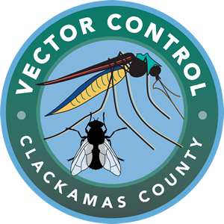
Various Vectors Ticks, Fleas, and More—Oh My!
FighttheBites.com
Notes:
Start the slide show using the buttons at the top or bottom of the screen. Discuss the content in these notes and on the lesson plan with students.
Slides 2, 4, 5, and 6 are adapted with permission from Eric Engh, Education Program / Insect Identification Specialist with Marin/Sonoma Mosquito & Vector Control District. More resources are available from their Mosquito School website: msmosquito.com/mosquito%20school

Slide 2
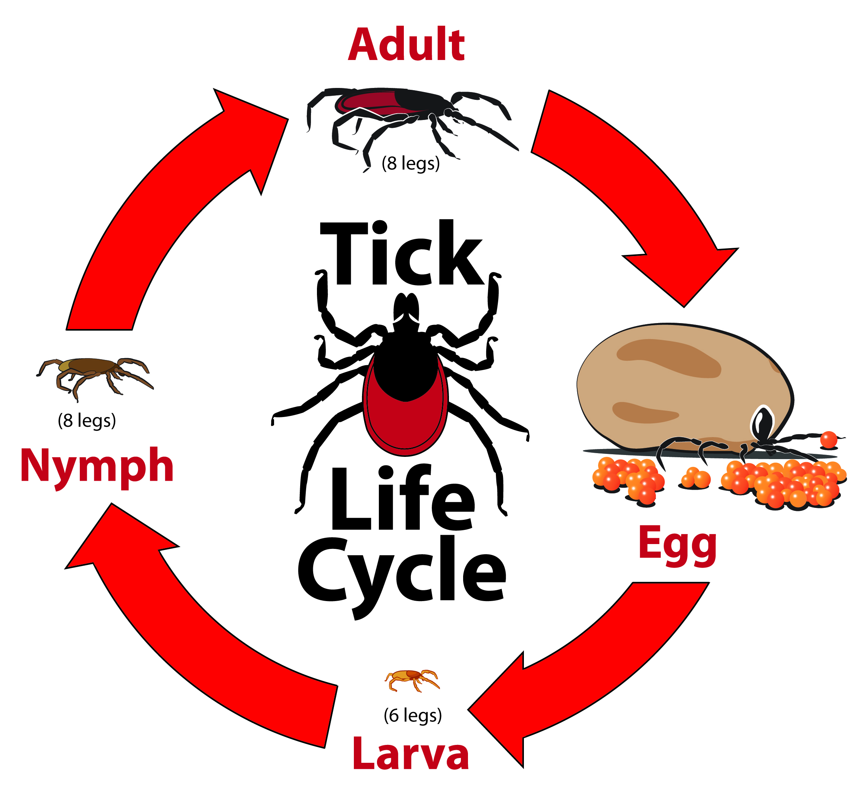
Ticks need blood to grow and reproduce
Notes:
Ticks are parasitic arachnids (like spiders--not insects). There are many different species (kinds) of ticks in the world, and the one in this image is a Western black-legged tick (also called a deer tick, like the blacklegged tick found in the Eastern half of the U.S.). It is found in Western Oregon and other Western states and is known to spread diseases such as Lyme disease.
All ticks require blood from a host or hosts. A host is the animal (or person) the tick bites to get the blood that it needs in order to grow to the next stage of its life or to lay eggs.
A tiny tick egg hatches into a tiny 6-legged tick larva. The larva must find an animal to bite in order to grow into a nymph. Ticks cannot jump or fly, so they wait for an animal to come close enough to them so they can climb on and bite. Tick larvae generally do not bite people. After biting the host, the larva drops off the host and molts into a nymph.
Explain that if the ticks meet their needs of water, blood meals, and warmth, there will be a metamorphosis as they transform from larvae into nymphs and nymphs into adults.
An 8-legged nymph is larger than a larva, but is still pretty small. An unfed nymph is only about the size of a poppy seed! Nymphs will bite people and can spread diseases. After the nymph gets the blood it needs, it drops off the host and can molt into an adult.
Adult ticks are much larger than nymphs. In this species the males are smaller than the females, but this is not always the case in ticks species. Both males and females feed on blood, and females take in a large amount of blood which is used to nourish thousands of eggs! The female drops off the host, and then deposits her eggs on the ground.
Ask the students, “How many times would an individual western black-legged tick need to bite an animal during its life in order to reproduce?” Answer: 3 times: once as a larva, once as a nymph, and once as an adult.

Slide 3
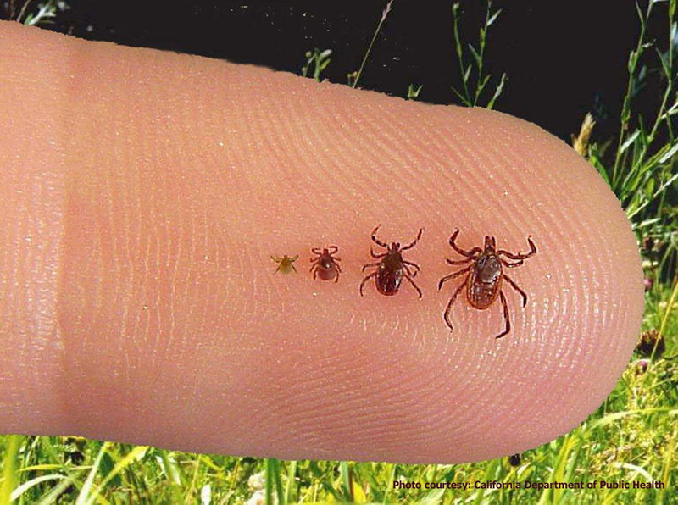
Western Black-legged Ticks
Notes:
The ticks can range in size, but are generally very small and hard to see, especially on dark clothing.
Creative Commons image source: https://www.flickr.com/photos/fairfaxcounty/7209178448

Slide 4
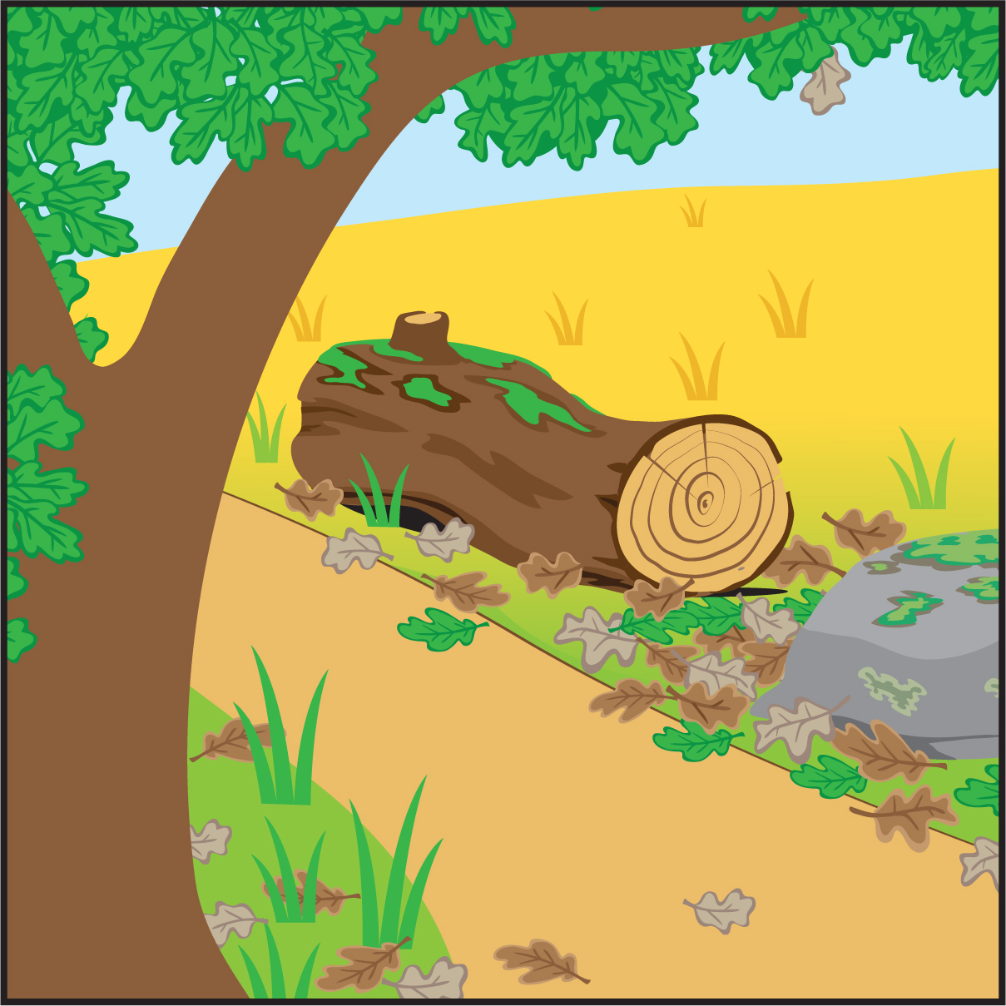
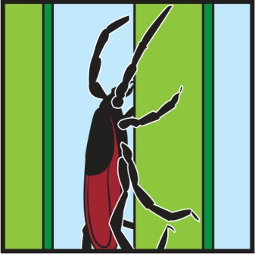
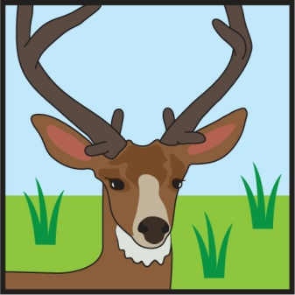
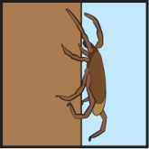
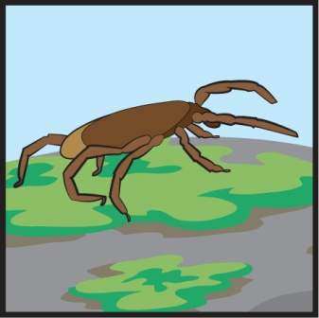
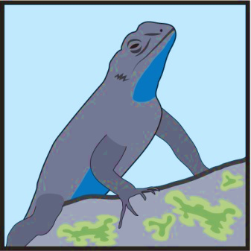
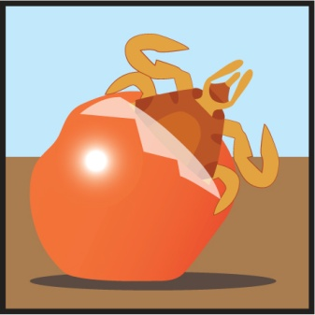
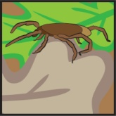
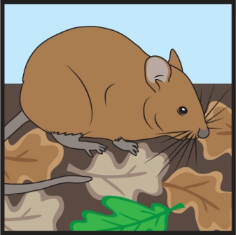
Tick Habitats + Hosts
Adult
Nymph
Larva
Notes:
Ticks are often found in natural places that people visit to hike, play or work. Not all tick habitat looks like this picture, but the picture shows some places where ticks could easily be found. The different life stages of ticks are often found in slightly different places within the habitat.
Eggs & Larvae are often found near the ground, especially in leaf litter. A larva hatches from an egg and waits to bite a small animal such as a rodent or bird that also spends time near the ground.
Nymphs may be found in leaf litter, but often climb up onto a mossy rock, log, or tree trunk to wait to bite an animal that is commonly found in these areas, such as a lizard or rodent. Remember, nymphs will also bite people!
Adults climb up tall grass or other plants, often alongside a trail, and wait to bite a large animal that passes by, like this deer in the picture. Adults will also bite people.

Slide 5
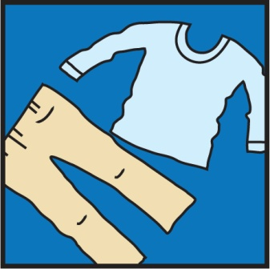
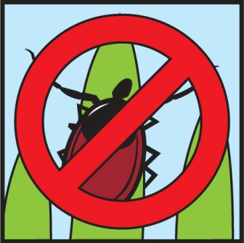
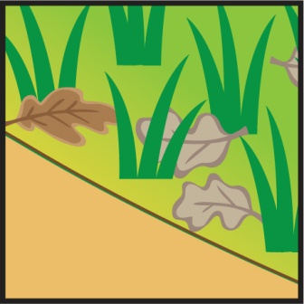
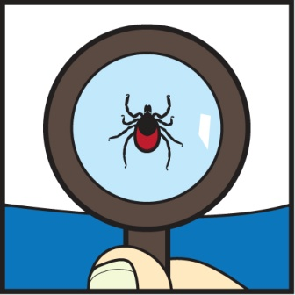
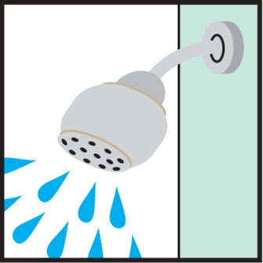
Safety Tips for visiting tick habitat
Before your visit:
During your visit:
After your visit:
Light colors, long pants / sleeves
Use Repellent
Center of trail
Check for ticks
Shower and check
Dry clothes on high heat

Slide 6
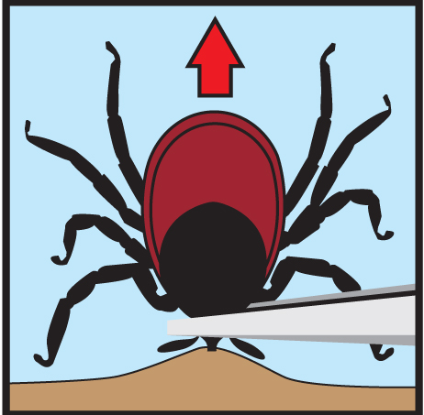
EEK! How to safely remove a tick if you are bitten:
Get help
Use tweezers to carefully grasp tick next to skin
Pull straight up.
Do not squish, burn, smother or twist ticks!
Notes:
Even if you are careful when you visit tick habitat, there is a chance that you may be bitten by a tick. If this happens, don’t panic, but find an adult as soon as possible. There are detailed directions for removing a tick on the CDC website: https://www.cdc.gov/ticks/removing_a_tick.html.
There are many myths about ways to remove ticks which can actually make the problem worse. The picture shows the best method of using tweezers to grasp the tick as close to the skin as possible and carefully pulling straight up.

Slide 7
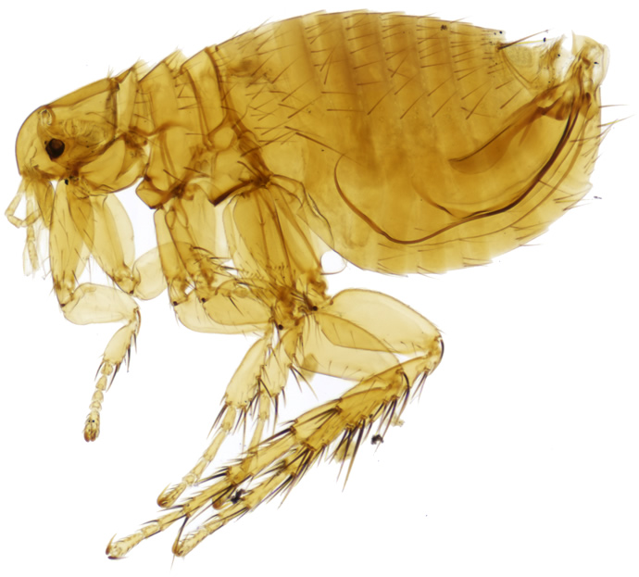
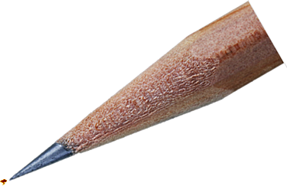
Other Possible Vectors Include . . .
Fleas
Very tiny
(1.5 – 3.3 mm)
Notes:
Flea adaptions:
● Strong legs help them jump more than 100 times their body height
● Special mouth parts for biting and sucking blood
● Flattened bodies to squeeze through fur and feathers
● Can live a long time without food
2,500 species of fleas worldwide
Public domain image sources:
https://upload.wikimedia.org/wikipedia/commons/c/c7/NHMUK010177265_The_plague_flea_-_Xenopsylla_cheopis_cheopis_%28Rothschild%2C_1903%29.jpg
https://commons.wikimedia.org/wiki/File:Pencil_Tip_Macro.jpg

Slide 8
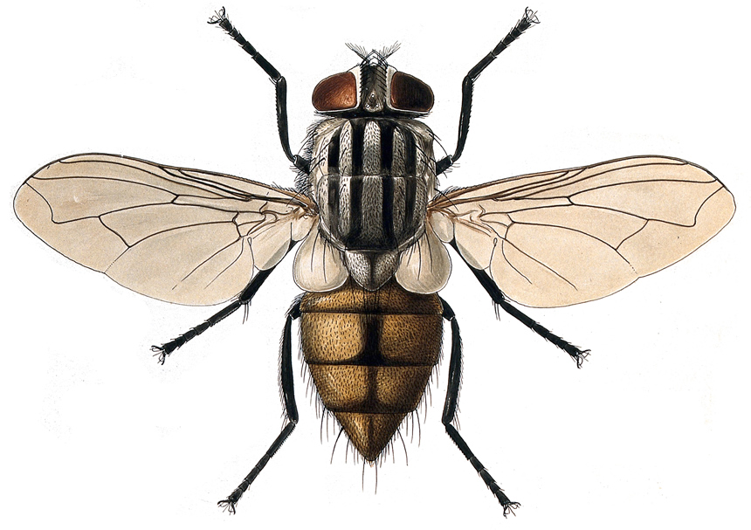
Flies
Notes:
● Regurgitate (throw up) and excrete when land on something, which can transmit many diseases
● Feed on feces and decaying matter
Public domain image sources:
https://upload.wikimedia.org/wikipedia/commons/c/c7/NHMUK010177265_The_plague_flea_-_Xenopsylla_cheopis_cheopis_%28Rothschild%2C_1903%29.jpg
https://commons.wikimedia.org/wiki/File:Pencil_Tip_Macro.jpg

Slide 9
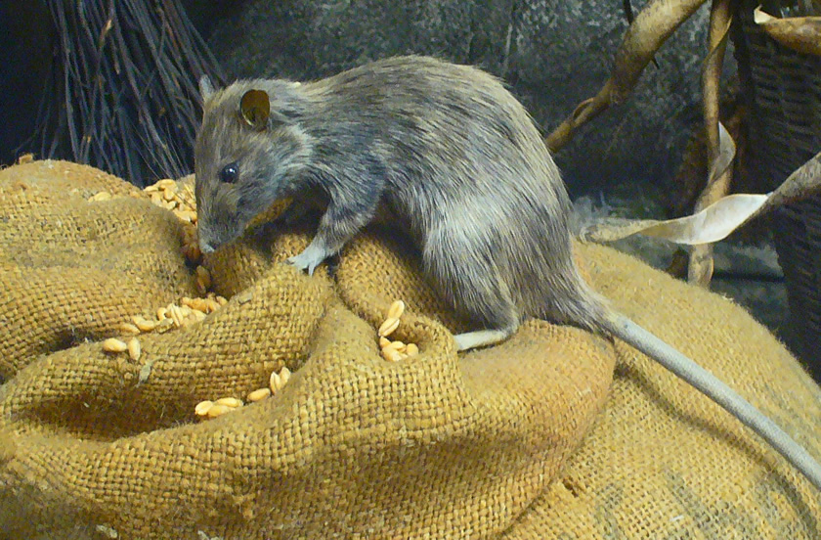
Rats and Other Rodents
Notes:
● Rats, mice, prairie dogs, and other rodents can transmit over 35 diseases
● Diseases can be spread directly through handling them or through their feces, urine, saliva, or bites
● Can carry fleas, ticks, and mites which can transmit disease indirectly, such as bubonic plague
Rodent-borne diseases: https://www.cdc.gov/rodents/diseases/direct.html
Public domain image sources:
https://upload.wikimedia.org/wikipedia/commons/c/c3/Rattus_rattus_01_reframed.JPG

Slide 10
Compare two organisms which can be disease vectors, such as:
Lice
Cats
Dogs
Ticks
Fleas
Flies
Rodents
Mites
Mosquitoes
Compare:
Life cycles
Adaptations
Where they are found
How they can spread disease
Notes:
See the “Various Vectors…” lesson plan for Adaptations / Extensions, including a simpler activity for younger students.

Slide 11
Visit Fightthebites.com
to learn more.
Notes:
Tell students that they will now have the opportunity to create a NEW organism which is adapted to suck blood from other organisms.

