Slide 1
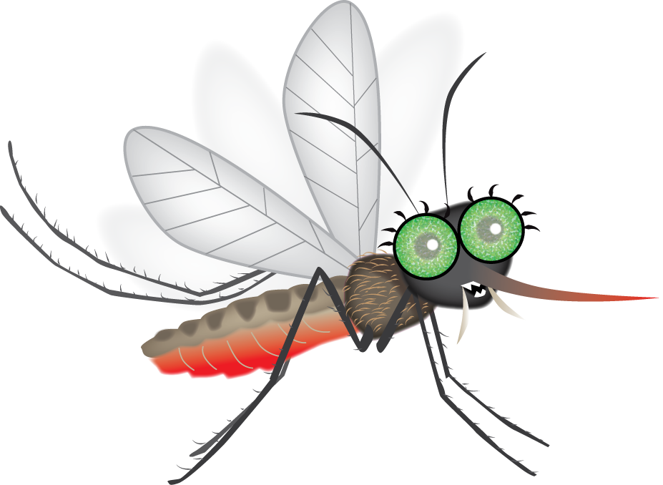
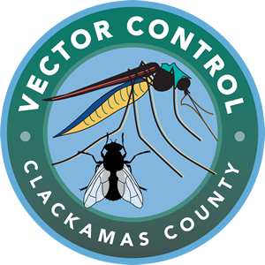
Adaptations of a Bold Blood Sucker
Beware of Mosquitula!
Notes:
Start the slide show using the buttons at the top or bottom of the screen. Discuss the content in these notes and on the lesson plan with students.

Slide 2
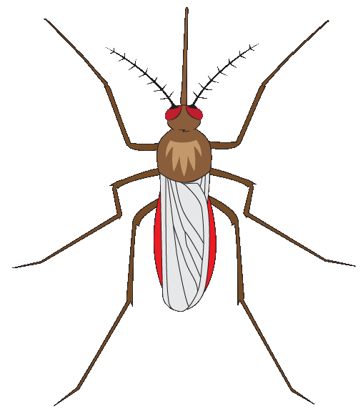
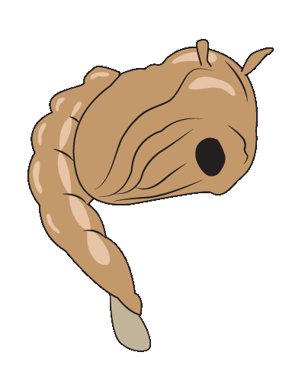
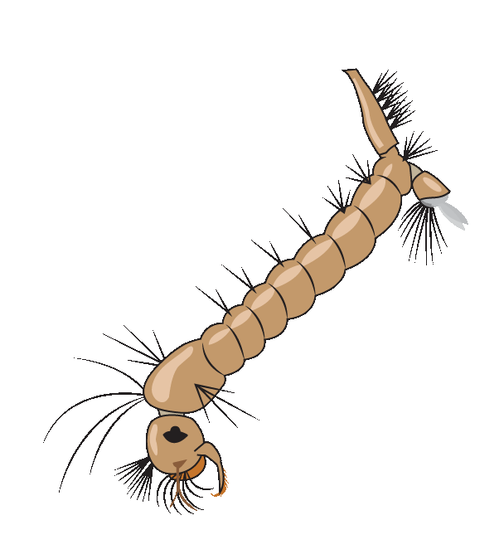
Warmth
Adult
Nectar
Blood
Pupa
Egg Raft
Larva
Notes:
Review of life cycle from previous class(es)
Tell students that mosquitoes have adaptations which help them survive at each stage of their life cycle.

Slide 3
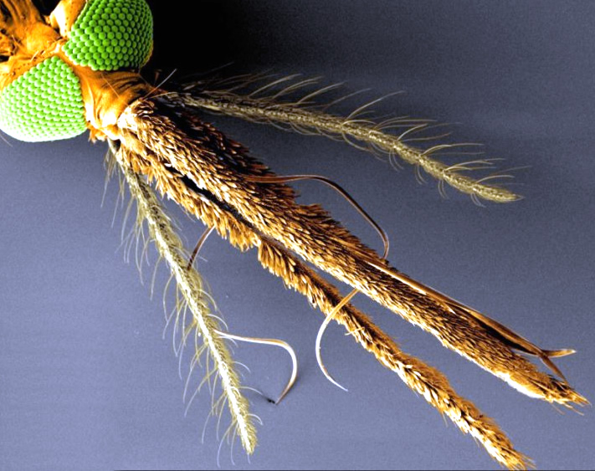
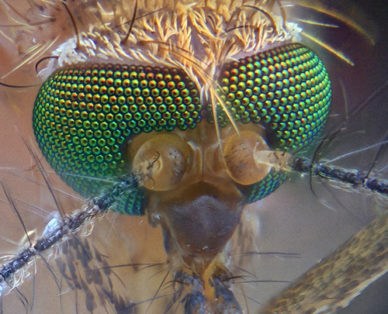
Adaptations of a Bold Blood Sucker
Wings
Antenna
Large compound eyes
Proboscis
Maxillary palps
Antenna
Abdomen
Six special legs
Notes:
Adult Mosquito Adaptations
Large compound eyes see you at night and detect body heat
Mosquito eyes image source: scienceinquirer: https://scienceinquirer.wikispaces.com/Microscope
Proboscis sucks blood
Image source of proboscis, etc: Science Daily: https://www.sciencedaily.com/images/2017/03/170317180341_1_900x600.jpg
Maxillary palps detect carbon dioxide and body odors
http://compmed.com/wp-content/uploads/2009/01/19-1.jpg
Antennae detect sound and wind
Abdomen swells with blood
Six feathery legs float on water and land on you undetected.
Long, narrow wings beat 800 times a SECOND to help mosquitoes hover.
PBS’ fascinating video “Deep Look: How Mosquitoes Use Six Needles to Suck Your Blood” explains how mosquitoes bite: www.pbs.org/video/deep-look-mosquitoes
The website “Mosquito Magnet” also has a excellent explanation with images of how mosquitoes bite: http://www.mosquitomagnet.com/articles/how-mosquitoes-bite

Slide 4
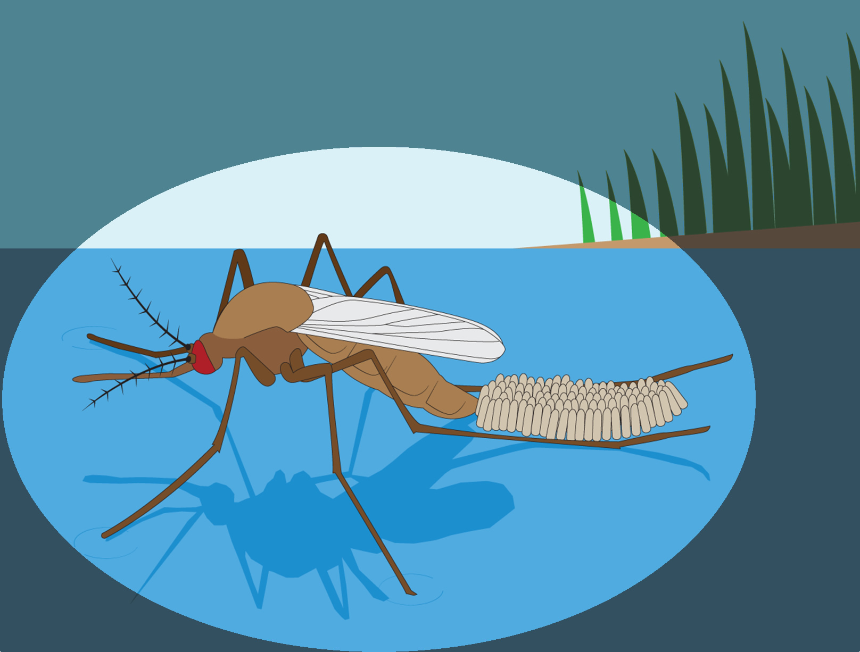
Egg Stage Adaptations
Notes:
“Mosquito eggs are usually elongated, about one millimeter long and they lay them in batches of 50-300 . . . Eggs can hatch in one to three days if laid on warm water.” Source: “Mosquito Biology.” Maryland Dept. of Agriculture: http://mda.maryland.gov/plants-pests/Pages/mosquito_biology.aspx
Many mosquito species lays their eggs on the surface of stagnant water (water that is not moving). Eggs fit together to create a floating raft.
More info: http://www.wumcd.org/mosquito/eggraft.html

Slide 5
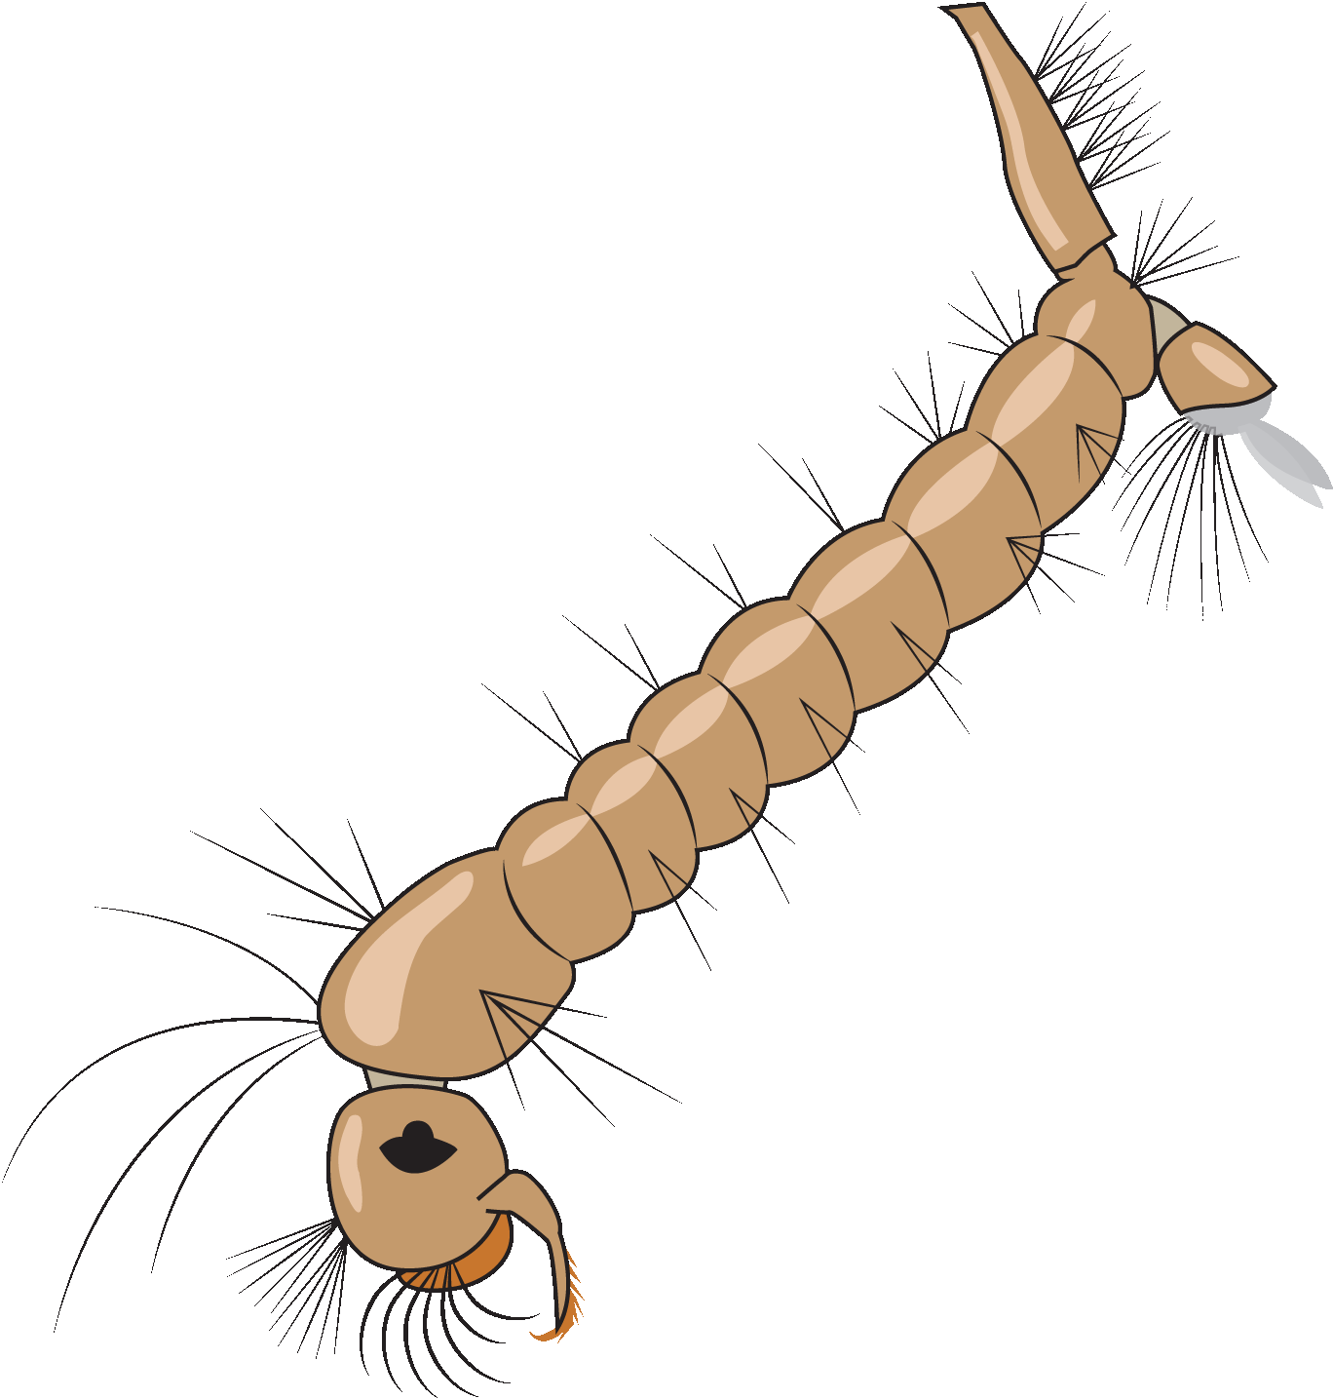
Larva Stage Adaptations
Breathing tube
Sensory
hairs
Mouth brushes
Notes:
“Brushes" draw food into the mouth.
Advanced: Breathing tube is called a siphon.

Slide 6
Notes:
Video of life mosquito larvae

Slide 7
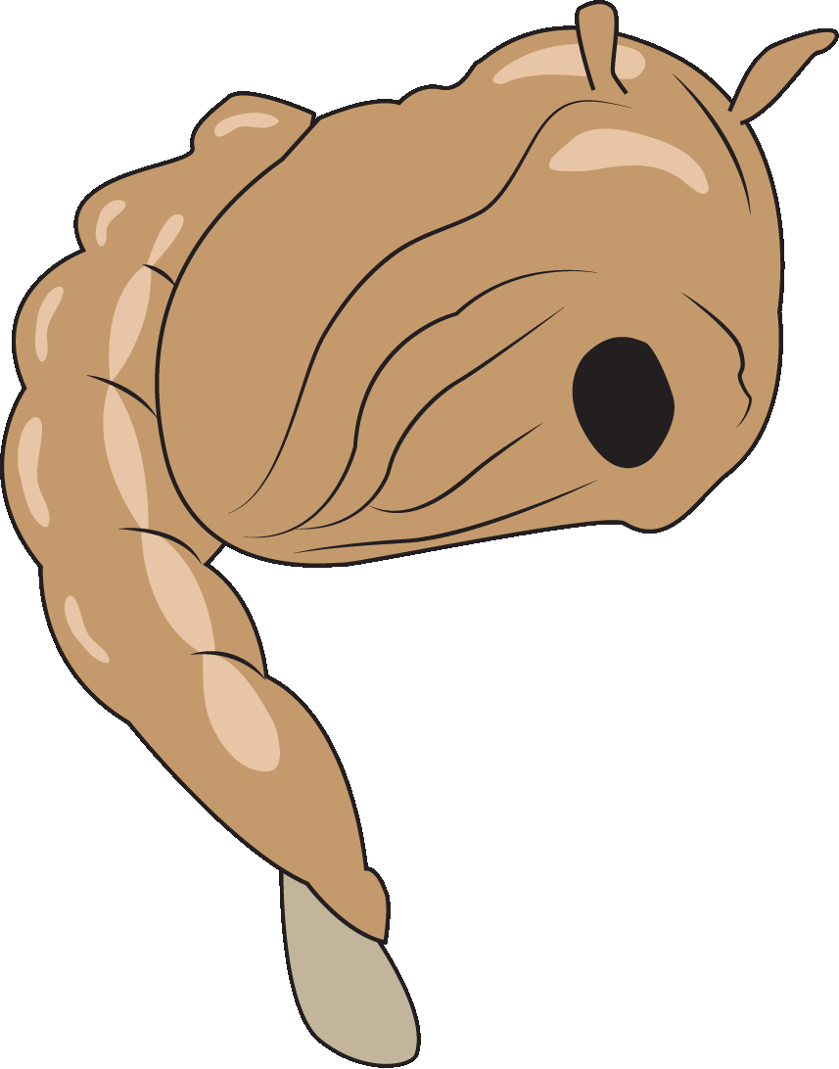
Pupa Stage Adaptations
Breathing tubes
Eyes
Paddles
Notes:
It takes about a week for a larva to change into a pupa if it has the food, water, air, and warmth that it needs.
In just one or two days a pupa can complete the metamorphosis into a flying adult that can live on land—and suck nectar and blood.

Slide 8
Notes:
Video of a live mosquito pupa

Slide 9
Adult
Pupa
Students
Egg Raft
Larva
Notes:
Ask students if they can remember the mosquito adaptations that were discussed for each stage. Ask students to spend a minute talking to a neighbor about mosquito adaptations and which adaptations they think are the most interesting.
Optional: Ask students to act out and/or draw and label the adaptations they remember.

Slide 10
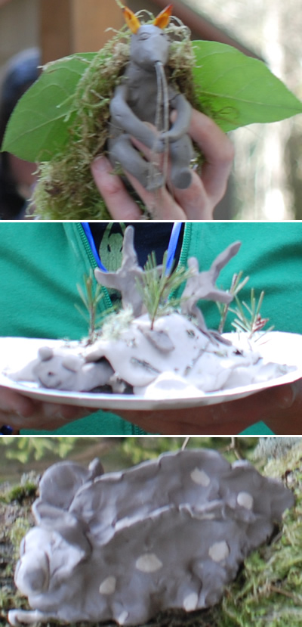
Create NEW Organisms
Adapted to suck blood
OR
Defend against blood-sucking
Explain adaptations in writing
Notes:
Tell students that they will now have the opportunity to create a NEW organism which is adapted to suck blood from other organisms.

