Slide 1
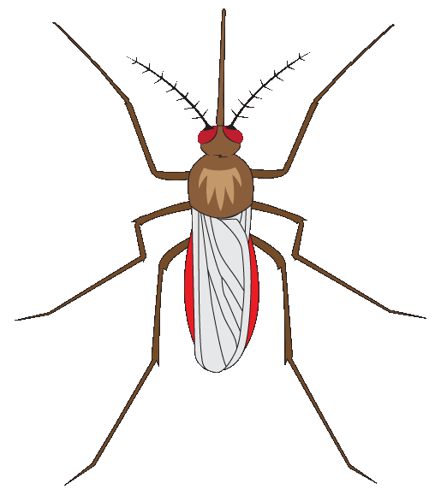
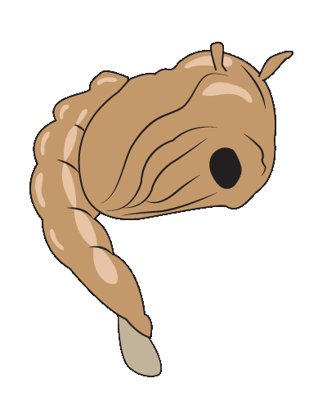
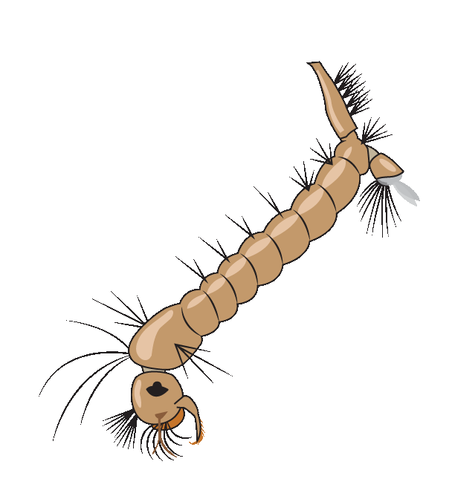
Warmth
Adult
Pupa
Egg Raft
Larva
Notes:
Start the slide show using the buttons at the top or bottom of the screen. Discuss the content in these notes and on the lesson plan with students.
Explain the mosquito life cycle and the following terms during the course of the presentation:
larva: young wingless form of an insect (such as a mosquito)
larvae: more than one larva
life cycle: stages in the life of an organism (egg, larva, pupa, and adult for many insects, such as mosquitoes)
metamorphosis: a major change some animals make between life stages to become adults
pupa: the stage of an insect’s life when it is changing from a larva into an adult
pupae: plural of pupa; pupae do not eat or move while they are transforming
vectors: animals which can spread disease, such as mosquitoes, flies, and ticks
vector-borne disease: sickness spread by a vector, such as West Nile virus and Zika virus

Slide 2
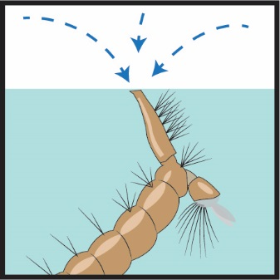
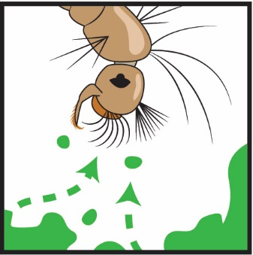
What does a mosquito larva need?
Water
Oxygen
Food
Warmth
Notes:
Larvae get oxygen from the surface
They suck in food like an underwater vacuum cleaner
They need warmth to develop into pupae

Slide 3
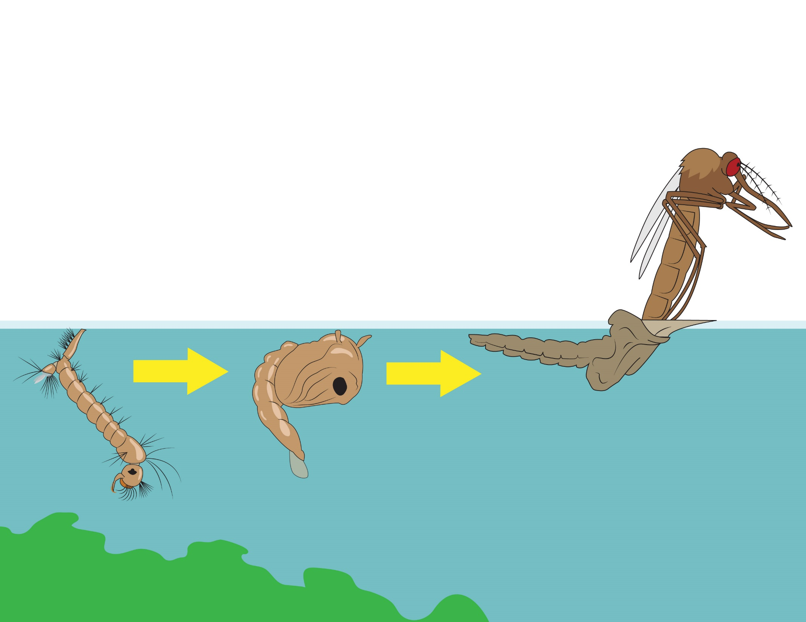
If a larva gets everything it needs, it will change…
Metamorphosis
Larva
Pupa
Adult
Notes:
Explain that if the mosquitoes meet their needs of water, food, and warmth, there will be a metamorphosis as they transform from larvae into pupae and pupae into adults.
Optional: Explain that mosquitoes, like all insects (and other arthropods like spiders and crustaceans), have an exoskeleton which protects their soft internal organs.

Slide 4
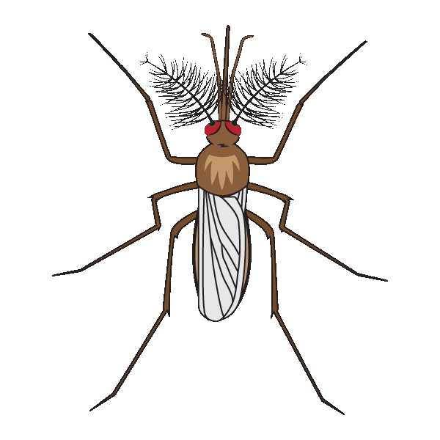
What do adult mosquitoes need?
Nectar
Blood
Protein for eggs...
Energy to fly...
Male
Female
Notes:
Antennae have different uses in males and females: https://asknature.org/strategy/antennae-sense-vibrations

Slide 5
Your Classroom Experiment
Notes:
Explain that students will be doing an experiment to count how many larvae, pupae, and adults are in the tank each day. They will take care of the mosquitoes so their habitat will help them grow and develop. But they will NOT have to let the adult females suck their blood!

Slide 6
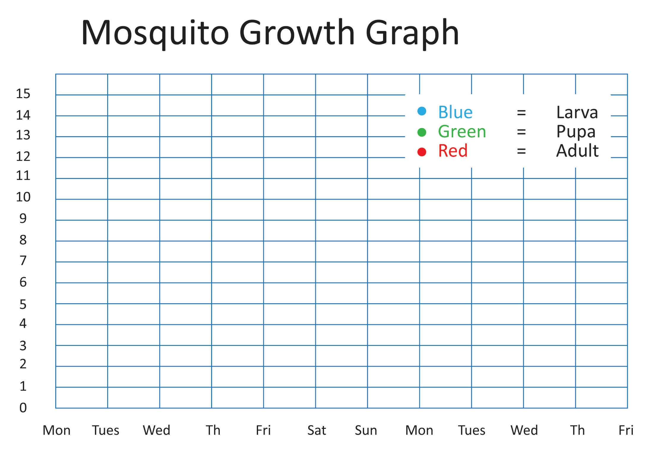
Notes:
Explain that students will record the data for how many larvae, pupae, and adults there are in the container each day. They will create line graphs with the data to show how the numbers changed over time.

Slide 7
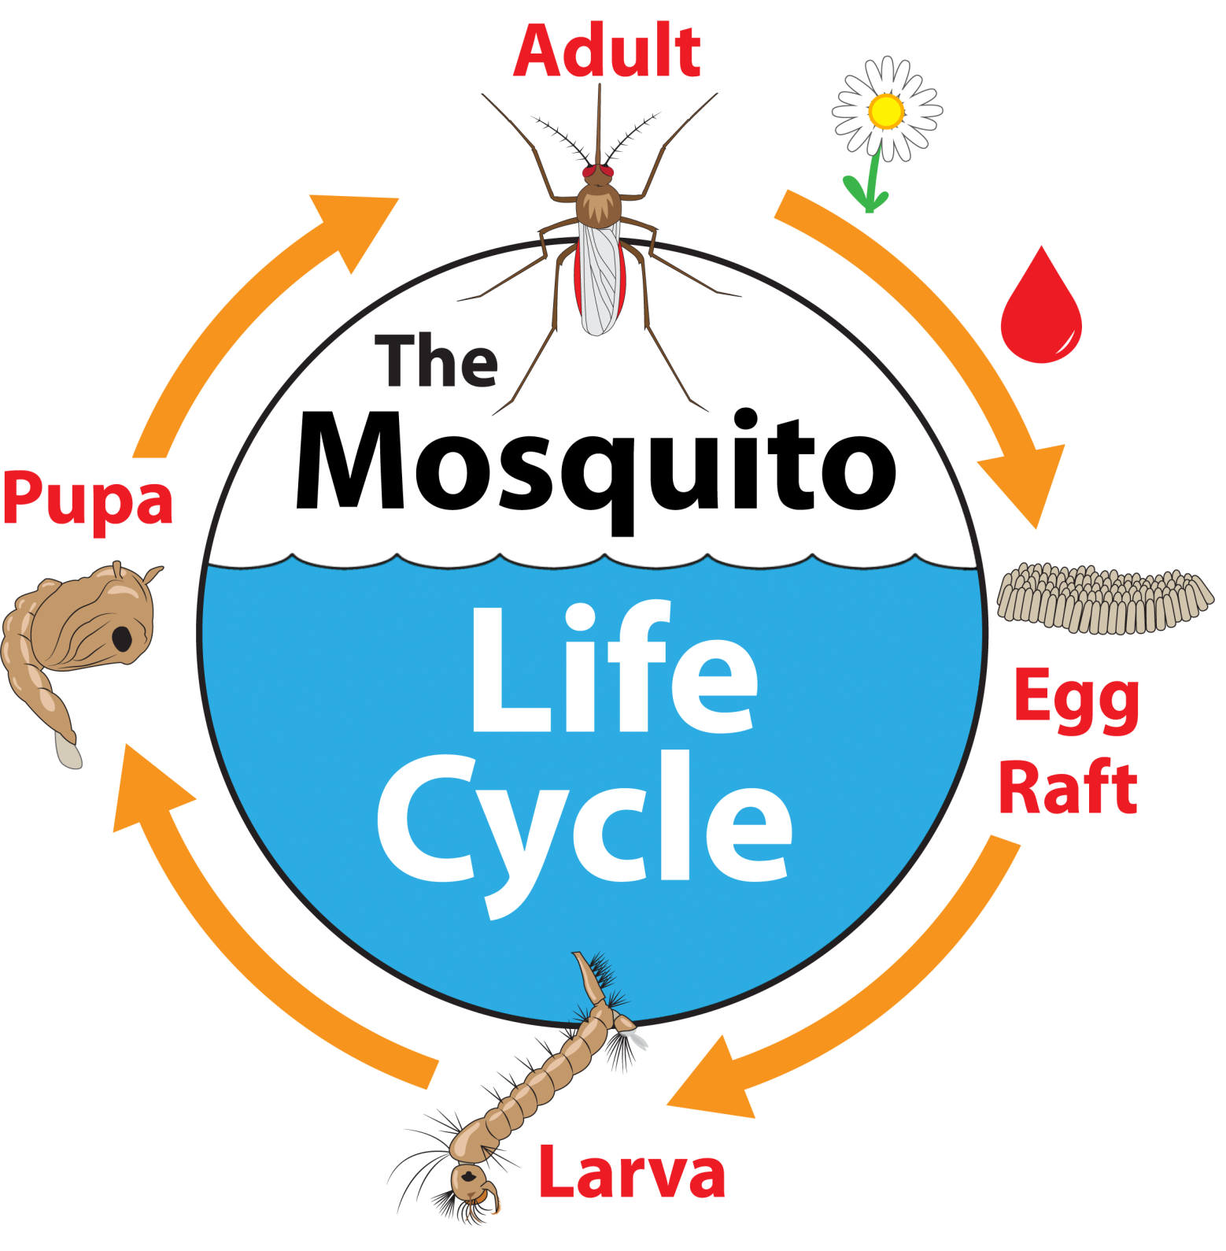
Notes:
The PowerPoint presentation was adapted with permission from Eric Engh, Education Program / Insect Identification Specialist with Marin/Sonoma Mosquito & Vector Control District. More resources are available from their Mosquito School website: msmosquito.com/mosquito%20school

